Slide 1

DEPARTMENT OF ARTIFICIAL INTELLIGENCE AND DATA SCIENCE ACADEMIC YEAR 2025 - 2026 SEMESTER III ARTIFICIAL INTELLIGENCE LABORATORY MINI PROJECT REVIEW AI-Powered Sudoku Solver
REGISTER NUMBER | 2117240070060
NAME | Dharani vendan S
YEAR | II
SECTION | A
FACULTY IN-CHARGE | Mrs. M. Divya

Slide 2
PROBLEM STATEMENT
The AI-Powered Sudoku Solver uses Artificial Intelligence techniques to automatically solve Sudoku puzzles of any difficulty level. The main goal is to build a system that understands the structure of a Sudoku grid, applies logical reasoning, and provides an accurate solution efficiently.
Expected Result: A system that can take any Sudoku puzzle as input and generate the correct solution using constraint satisfaction and backtracking algorithms.
Clearly introduce the topic, provide background context, explain why the problem matters, and highlight what the project aims to accomplish.
Clear and Precise Problem Statement
Expected result and the possibilities for the given problem statement

Slide 3
THEORETICAL BACKGROUND
The project is based on Artificial Intelligence search and constraint satisfaction principles. Algorithm Used: Backtracking Algorithm The Backtracking algorithm is a recursive approach that tries to fill empty Sudoku cells one by one, checking if the placement is valid at each step. If a conflict is found, the algorithm backtracks to the previous step and tries a new number.
Justification: Backtracking ensures correctness and completeness while maintaining reasonable computational complexity for a 9x9 Sudoku grid. Example: If the number 5 in row 1 column 3 causes a conflict, the algorithm reverts and tries 6, continuing until a valid configuration is found.
Literature survey of the given problem and other possible algorithms
Justification for choosing the algorithm
Explanation of Algorithm with appropriate example

Slide 4
IMPLEMENTATION AND CODE
GitHub Repository:
https://github.com/dharanivendan-star/AI-DV-MINI-PROJECT
List | Git-hub Repository Links
Implementation of Code Link | LINK
Word Document Report Link | LINK
PPT Link | LINK

Slide 5
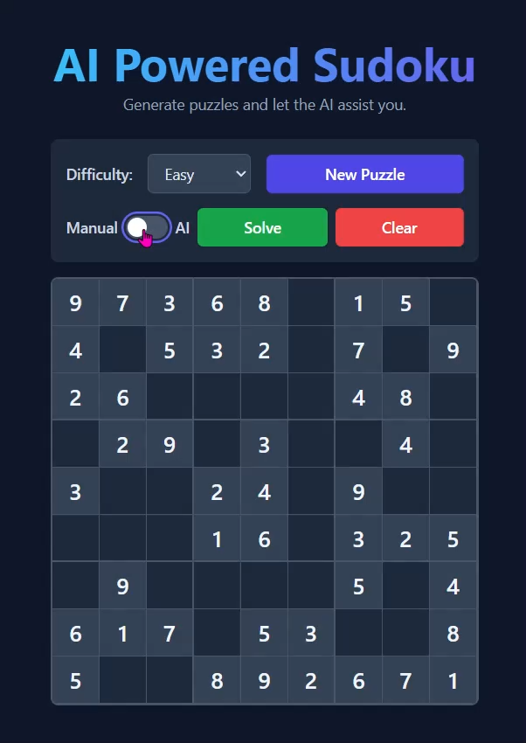
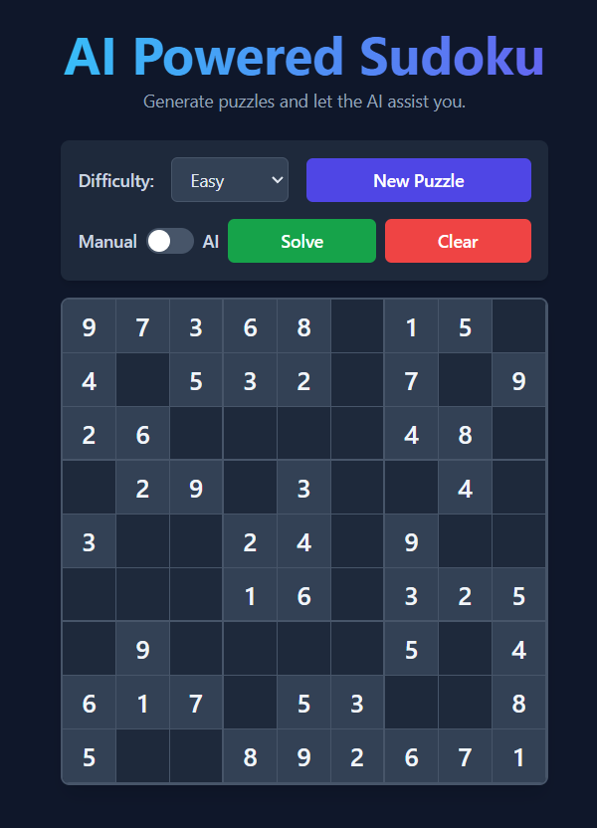
OUTPUT AND RESULTS
Output Screen shots:

Slide 6
OUTPUT AND RESULTS
Explanation:
When you run the python code , displays the output screen as above.
Select how the level is difficultly , either easy or medium or hard or expert level.
When you turn on the AI mode ,when you click on AI step it will automatically
generate the number to be filled in the next empty box by backtracking algorithm.
There is also a manual method ,you can try, if you place the wrong number in the particular place ,it will show in red color.
When you click the Solve the puzzle is solved.
When the clear button is clicked it cleared numbers you or AI filled in the puzzle and to start from first.

Slide 7
OUTPUT AND RESULTS
Results and Future Enhancements:
The project successfully demonstrates AI-based problem solving in a real-time interactive application. The backtracking algorithm performs accurately and efficiently for 9x9 Sudoku boards. Future improvements could include: - Step-by-step solving visualization. - Integration of image recognition for handwritten Sudoku. - Deployment as a web or mobile app. - Use of machine learning to optimize puzzle generation.

Slide 8
REFERENCES
1. Stuart Russell, Peter Norvig - Artificial Intelligence: A Modern Approach 2. GeeksforGeeks - Backtracking Algorithm Tutorials 3. Towards Data Science Blog - Sudoku Solvers using AI 4. Python.org Documentation - Recursion and Constraint Satisfaction Problems 5. ResearchGate Paper - Efficient Sudoku Solving Algorithms (May be books/on-line resources (E-Books, standard Videos and blogs Strictly no conversational agents like ChatGPT, Gemini etc.,)

